Slide 1


Slide 2

Cost and Carbon Analysis of the Impact of Inaction Final Presentation
City of Pittsburgh Sustainability and Resilience Division
Carnegie Mellon University
Heinz College of Information Systems and Public Policy
Faculty Advisor: Edson Severnini

Slide 3
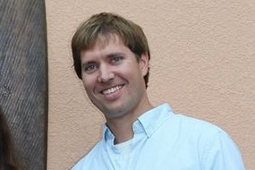





Student Team
Patrick Campbell
Shule (Barry) Chen
Kensuke Onishi
Adhiraj Shekhawat
Chanté Solomon
Haoran Yan

Slide 4
Agenda
Introductions
Framing the Problem
Approach
Decision Support Tool v.1
Decision Support Tool v.2
Product Demo
Challenges and Limitations
Recommendations for Future Work
Acknowledgements
Q&A

Slide 5
Framing the Problem

Slide 6
About the Client
City of Pittsburgh Division of Sustainability and Resilience
Mission Statement:
“Sustainability and resilience empowers all Pittsburghers to address the climate crisis through reducing pollution, improving access to food, and integrating the environment into their daily decisions. As a division, we champion preventative resilience strategies in partner operations in order to mitigate stressors facing the City and prepare for future shocks. We also advise City officials, departments and partners to enable an enduring and adaptable city through holistic decision making.”
Rebecca Kiernan, Principal Resilience Planner
Flore Marion, Energy Advisor
Grant Ervin, Chief Resilience Officer

Slide 7
Context and Problem Statement
Context
Client: City of Pittsburgh’s Division of Sustainability and Resilience
City would like to better anticipate and respond to the impacts of climate change on public facilities and the communities they service
Problem Statement
How should the City allocate funding to the maintenance and renovation of its building stock in order to maximize resilience value to the community while minimizing long-term costs?

Slide 8
Scope
Healthy Active Living Centers (HALCs) used as a case study
Fill the gap between current evaluation frameworks (NZE - Net Zero Energy) and a more holistic resilience-oriented planning framework
Air quality
Extreme temperature
Flooding
Landslides
Synergy between building and environment

Slide 9
Healthy Active Living Centers (HALCs)
Year-round City-operated centers serving persons 60 years and older by addressing physical, intellectual, social, cultural, & financial needs
35 centers total
6 priority centers
Ammon Recreation Center
Brighton Heights Senior Center
Homewood Senior Center
Magee Recreation Center
Sheraden Senior Center
Southside Market House

Slide 10
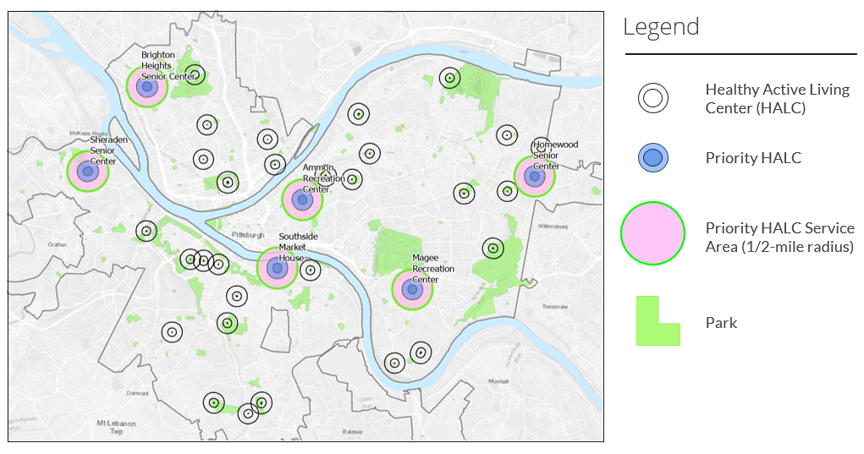

Slide 11
Approach

Slide 12
Initial Approach
Market-based approach
HALC prioritization model

Slide 13
Decision Support Tool v.1

Slide 14
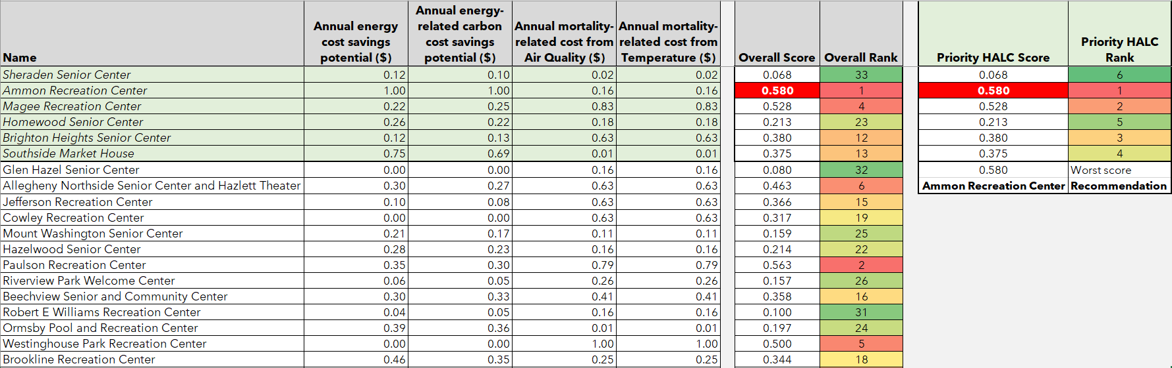
Use Case #1

Slide 15
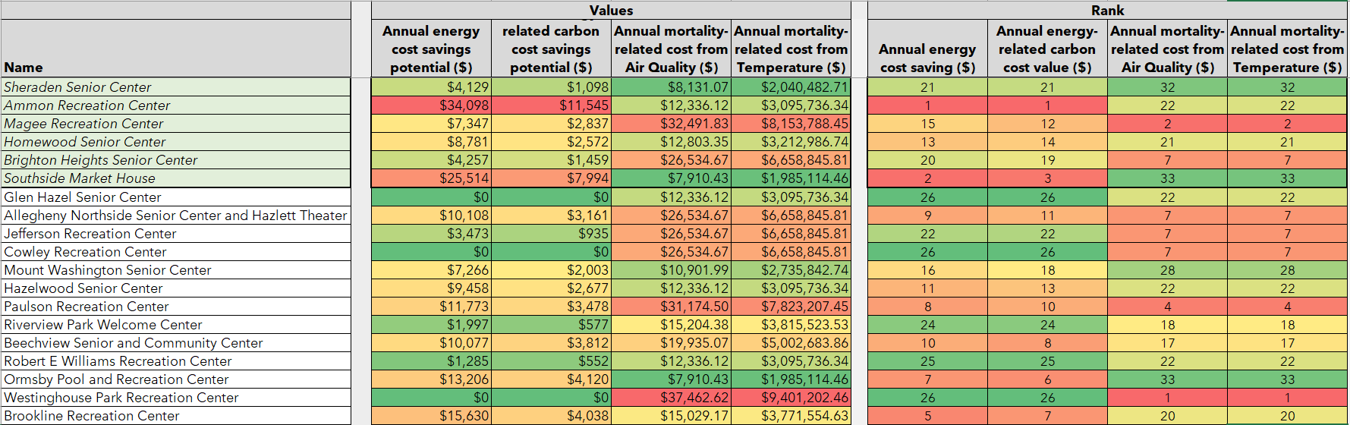
Use Case #2

Slide 16
Decision Support Tool v.2

Slide 17
Steps to approach the problem
Identification of HALCs that are at risk due to extreme weather events
Calculating the maximum possible benefits for each category of environmental risk
Creating a retrofit recommendation engine for each HALC

Slide 18
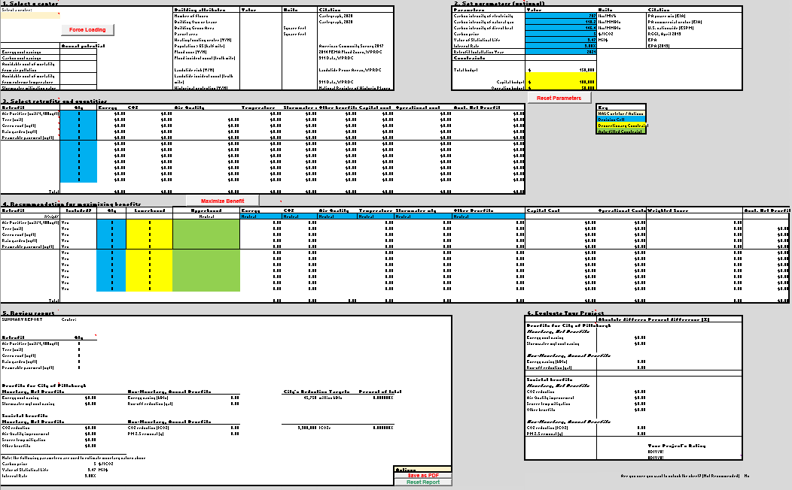
Use Case #1: Proposing revisions to budget proposal

Slide 19
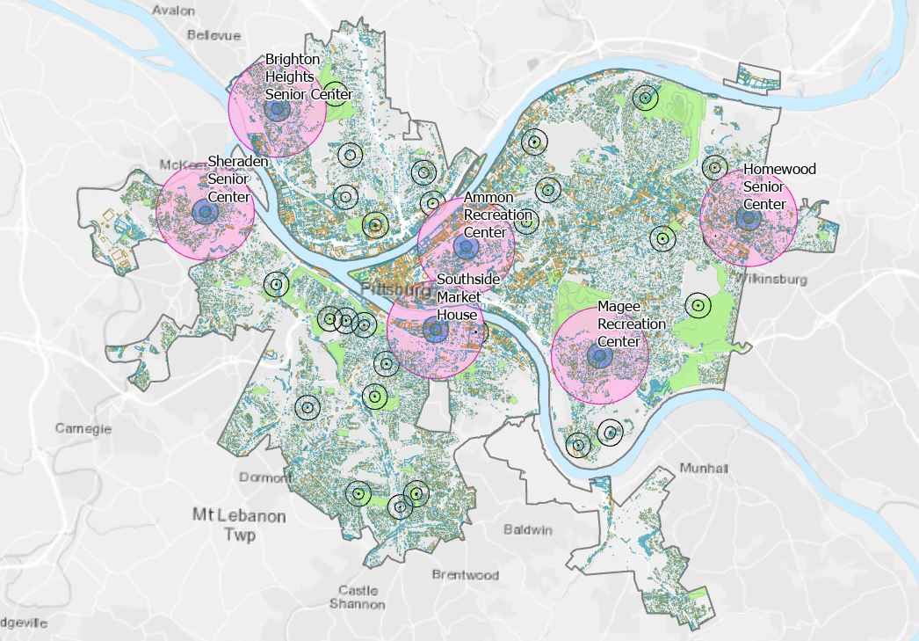
Use Case #2: Grant preparation

Slide 20
Resilience Oriented Planning Map
(Hazards Map)

Slide 21
Using the Map
Explore location of HALCs in relation to environmental hazards
Flood zones
Landslide prone areas
Air pollution
Run analyses to obtain center-specific data
Community demographics
Number of hazardous incidents
Parcel area
Roof area
Export results to Decision Support Tool for further analysis and planning of retrofit projects

Slide 22
Hazards Map: Demo

Slide 23
Decision Support Tool

Slide 24
Cost Benefit Analysis of Retrofits
Capital expenditure
Energy
Carbon
Air Quality
Operating expenditure
Temperature
Stormwater Management
Other Values

Slide 25
Cost Benefit Analysis of Retrofits
Energy saving = [Energy saved by the retrofit] x [Energy cost per unit]
Carbon emissions reduction = [Carbon emissions reduced] x [Carbon price]
Air quality improvement = [Pollutants removed] x [avoided mortality per unit] x VSL
Temperature
Stormwater management = [Annual precipitation in Pittsburgh]
x [rainwater retention rate of the retrofit] x [avoided cost per gallon]
Other values
Aesthetic values of green infrastructure which improve property values
Other benefits for facility users and broader societal values

Slide 26
Process Guideline
Select a center
Set parameters
Choose retrofits and quantities
Run optimization
Generate report
Evaluate your project

Slide 27
Demo

Slide 28

Demo
[Insert playable video or link to video on YouTube]

Slide 29
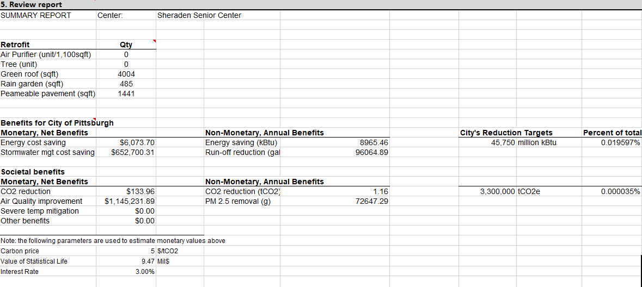
Output Example

Slide 30
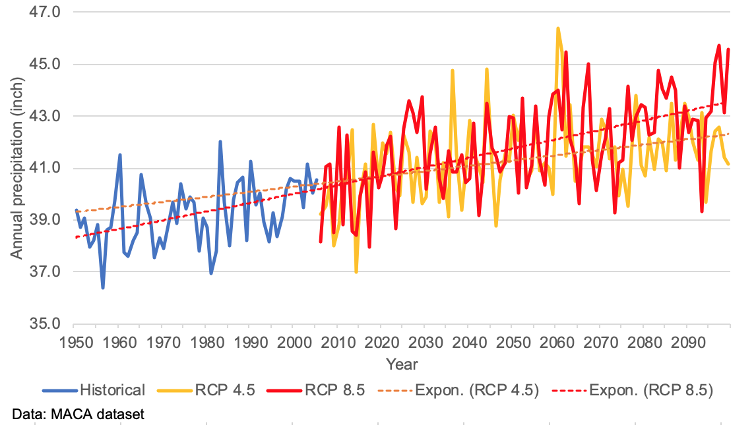
Climate projection: annual precipitation in Pittsburgh

Slide 31
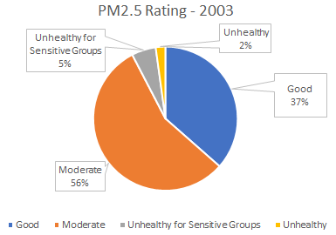
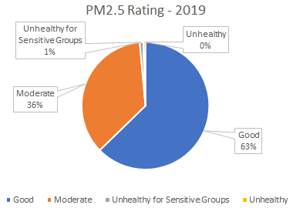
Climate projection: PM2.5 Concentration Trend

Slide 32
Challenges and Limitations

Slide 33
Challenges and Limitations
Estimating benefit provided by a typical air purifier
Projected effects of climate change on attributes
Inversion events
Landslides and flooding

Slide 34
Recommendations for Future Work

Slide 35
Recommendations for Future Work
Consideration for Interoperability with Cartegraph
Updating and Quality Assurance/Quality Control of source data sets
Addition/update of retrofits with engineering expertise

Slide 36
Acknowledgements

Slide 37
People
Grant Ervin
Rebecca Kiernan
Flore Marion
Sarah Yeager
Erin Copeland
Michelle Fanzo
Casimir Pellegrini
Matthew Jacob
Felipe Palomo
Lisa Ceoffe
Azizan Abdul-Aziz
Jonathan Caulkins
Matthew Mehalik
Albert Presto
Constantine (Costa) Samaras
Tania Lopez Cantu
Kara Smith
Courses
Cost Benefit Analysis (Mary Ellen Benedict)
Climate Change Adaptation (Constantine Samaras)
Decision Analysis and Multi-Criteria Decision Making (Jonathan Caulkins)
Geographic Information Systems (Chris Goranson)

Slide 38
Questions?

